Slide 1
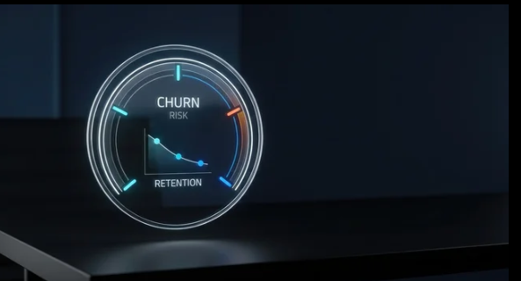
CUSTOMER CHURN AND REVENUE LOSS DESCRIPTIVE ANALYSIS
BY
RACHAEL
JOB TITLE: Data Analyst

Slide 2
EXECUTIVE SUMMARY
Executive Summary
Business Objectives: The aim of the data analysis is conduct a descriptive analysis on customer churn, revenue generation and loss of a fictional retail store

Slide 3
METHODOLOGY
Executive Summary
Data source: The datasets were sourced from Kaggle Customer Behavior & Churn Prediction Dataset V2.
It contained 6 tables namely customer summary, customers, orders, payments and engagements. The merged table had 1,071,900 records.
Data Extraction and Joining: Postgres was deployed for creating, importing and joining tables.
Data Cleaning: Power Query was used for data cleaning
Descriptive Analysis: PowerBI was used for comprehensive data anlaysis

Slide 4
RESULT ON CUSTOMER CHURN ANALYSIS
Executive Summary
There are 500,000 unique customers patronizing the fictional store from year 2019-2026.
The aggregate number of customer churned from 2019-2025 are 104,000.
The numbers of customer churned from year 2019-2025 is within 24,3000 – 24,3000 customers. However the numbers of customer churn drastically reduced to 10,500 in 2026.
Customers over the age of 50 has highest number of churn, while customer between 18-25 have the lowest churn rate.
Customers within basic membership tier has the highest customer churn number of 57,000 while members within Platinum group has the lowest customer churn of 5,000.

Slide 5
RESULT ON REVENUE ANALYSIS
Executive Summary
Total revenue accrued from 2019-2026 is $50.05bilions
Total revenue from churned customer is $6.33 billions
Percentage of revenue loss is 7.91%
The year2025 has the highest revenue with a revenue of $6,4 billion
Home product category has the highest revenue with a revenue of $9,5 billion
Customers over the age of 50 has the highest revenue

Slide 6
RECOMMENDATION
Executive Summary
The store should increase investment on Home product category since it has the highest revenue
There is a paradox in the analysis the age group with highest revenue and highest churn is customers over 50 years. The store should take pragmatic steps to attract and retain customers in the group.
Cart abandon rate and wish list items. Wish list items are 27 millions are high this connotes not all customers have high purchasing power. The store should invest in low-priced products.
Total payment failure time was 3 millions. The store should improve its network capacity and improve payment methods.

Slide 7
THANKS FOR YOUR TIME

